Slide 1

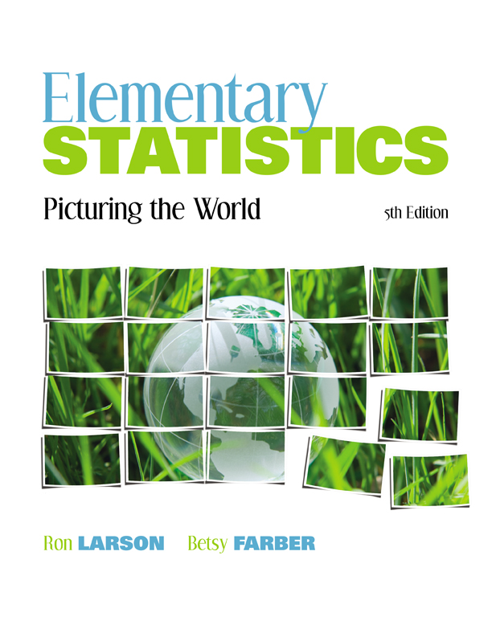

Chapter
5
Normal Probability Distributions
© 2012 Pearson Education, Inc.
All rights reserved.
<number> of 105

Slide 2
Chapter Outline
5.3 Normal Distributions: Finding Values
© 2012 Pearson Education, Inc. All rights reserved.
<number> of 105

Slide 3
Section 5.3
Normal Distributions: Finding Values
© 2012 Pearson Education, Inc. All rights reserved.
<number> of 105

Slide 4
Section 5.3 Objectives
Find a z-score given the area under the normal curve
Transform a z-score to an x-value
Find a specific data value of a normal distribution given the probability
© 2012 Pearson Education, Inc. All rights reserved.
<number> of 105

Slide 5
Finding values Given a Probability
In section 5.2 we were given a normally distributed random variable x and we were asked to find a probability.
In this section, we will be given a probability and we will be asked to find the value of the random variable x.
5.2
x
z
probability
5.3
© 2012 Pearson Education, Inc. All rights reserved.
<number> of 105

Slide 6
Example: Finding a z-Score Given an Area
Find the z-score that corresponds to a cumulative area of 0.3632.
Solution:
0.3632
z
z
0
© 2012 Pearson Education, Inc. All rights reserved.
<number> of 105

Slide 7


Solution: Finding a z-Score Given an Area
Locate 0.3632 in the body of the Standard Normal Table.
The z-score is –0.35.
The values at the beginning of the corresponding row and at the top of the column give the z-score.
© 2012 Pearson Education, Inc. All rights reserved.
<number> of 105

Slide 8
Example: Finding a z-Score Given an Area
Find the z-score that has 10.75% of the distribution’s area to its right.
Solution:
1 – 0.1075
= 0.8925
0.1075
z
0
z
Because the area to the right is 0.1075, the cumulative area is 0.8925.
© 2012 Pearson Education, Inc. All rights reserved.
<number> of 105

Slide 9

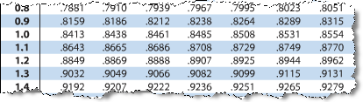
Solution: Finding a z-Score Given an Area
Locate 0.8925 in the body of the Standard Normal Table.
The z-score is 1.24.
The values at the beginning of the corresponding row and at the top of the column give the z-score.
© 2012 Pearson Education, Inc. All rights reserved.
<number> of 105

Slide 10
Example: Finding a z-Score Given a Percentile
Find the z-score that corresponds to P₅.
Solution:
The z-score that corresponds to P₅ is the same z-score that corresponds to an area of 0.05.
0.05
z
z
0
The areas closest to 0.05 in the table are 0.0495 (z = –1.65) and 0.0505 (z = –1.64). Because 0.05 is halfway between the two areas in the table, use the z-score that is halfway between –1.64 and –1.65. The z-score is –1.645.
© 2012 Pearson Education, Inc. All rights reserved.
<number> of 105

Slide 11
Transforming a z-Score to an x-Score
To transform a standard z-score to a data value x in a given population, use the formula
x = μ + zσ
© 2012 Pearson Education, Inc. All rights reserved.
<number> of 105

Slide 12
Example: Finding an x-Value
A veterinarian records the weights of cats treated at a clinic. The weights are normally distributed, with a mean of 9 pounds and a standard deviation of 2 pounds. Find the weights x corresponding to z-scores of 1.96, –0.44, and 0.
Solution: Use the formula x = μ + zσ
z = 1.96: x = 9 + 1.96(2) = 12.92 pounds
z = –0.44: x = 9 + (–0.44)(2) = 8.12 pounds
z = 0: x = 9 + (0)(2) = 9 pounds
Notice 12.92 pounds is above the mean, 8.12 pounds is below the mean, and 9 pounds is equal to the mean.
© 2012 Pearson Education, Inc. All rights reserved.
<number> of 105

Slide 13

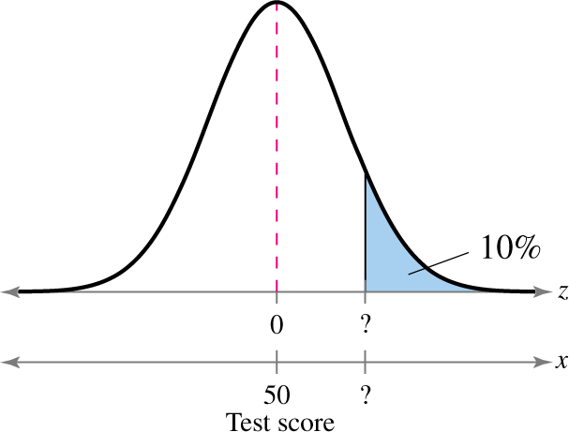
Example: Finding a Specific Data Value
Scores for the California Peace Officer Standards and Training test are normally distributed, with a mean of 50 and a standard deviation of 10. An agency will only hire applicants with scores in the top 10%. What is the lowest score you can earn and still be eligible to be hired by the agency?
Solution:
An exam score in the top 10% is any score above the 90th percentile. Find the z-score that corresponds to a cumulative area of 0.9.
© 2012 Pearson Education, Inc. All rights reserved.
<number> of 105

Slide 14
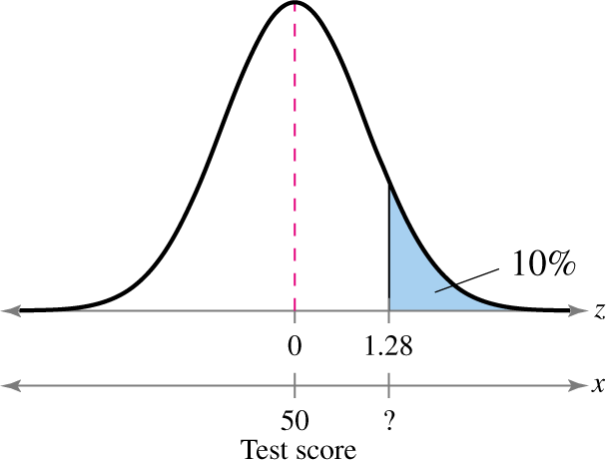
Solution: Finding a Specific Data Value
From the Standard Normal Table, the area closest to 0.9 is 0.8997. So the z-score that corresponds to an area of 0.9 is z = 1.28.
© 2012 Pearson Education, Inc. All rights reserved.
<number> of 105

Slide 15
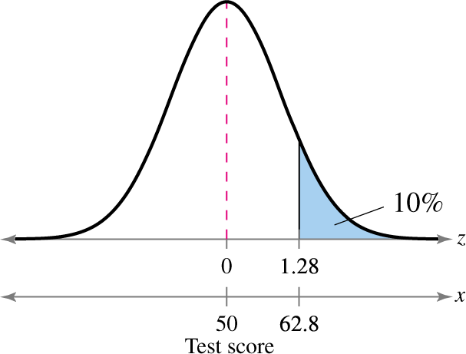
Solution: Finding a Specific Data Value
Using the equation x = μ + zσ
x = 50 + 1.28(10) = 62.8
The lowest score you can earn and still be eligible to be hired by the agency is about 63.
© 2012 Pearson Education, Inc. All rights reserved.
<number> of 105

Slide 16
Section 5.3 Summary
Found a z-score given the area under the normal curve
Transformed a z-score to an x-value
Found a specific data value of a normal distribution given the probability
© 2012 Pearson Education, Inc. All rights reserved.
<number> of 105

